Slide 1
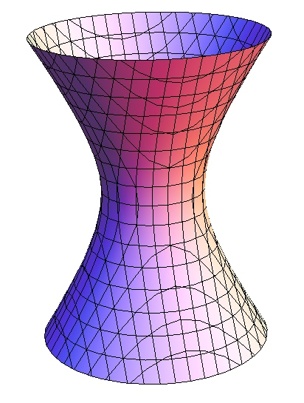
Properties of Symbols on a Hyperboloid
Simon Browning
Advisor: Dr. Alexander Karabegov

Slide 2
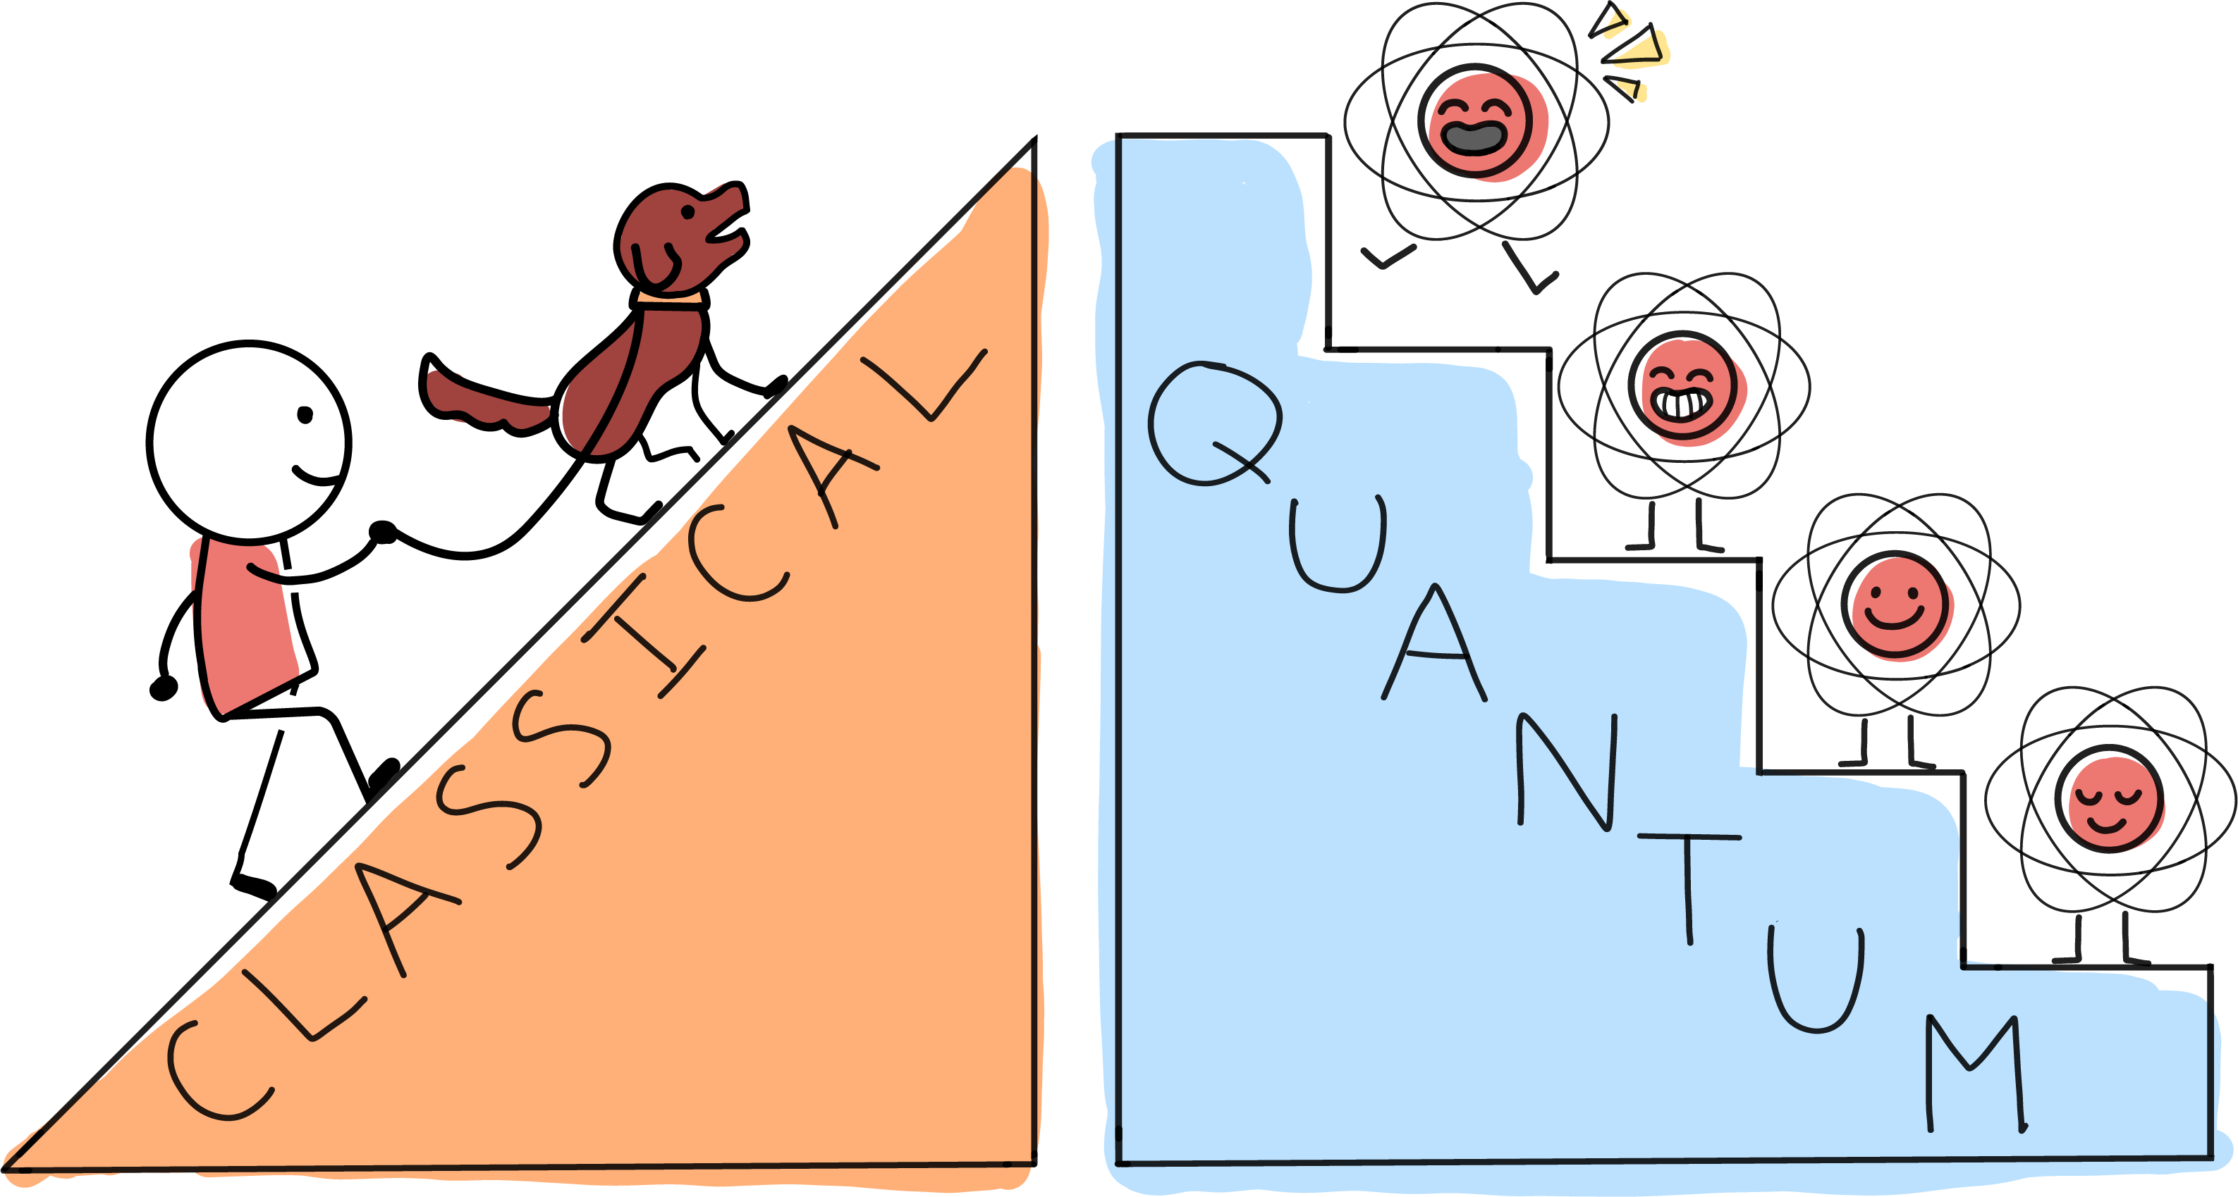
Classical Vs. Quantum Mechanics
Classical Mechanics (CM) – What we experience on a daily basis.
Quantum Mechanics (QM) – Applies at the subatomic level.
Fundamentally distinct – QM only allows physical properties of a system, such as momentum and energy, to exist in discrete quantities.
The Quantum Atlas

Slide 3




Flat Phase Space
Describes physical systems in terms of position and momentum.
The canonical coordinates $p$ and $q$can be used to generate the Heisenberg Lie algebra satisfying the commutation relations: $\left[p,q\right]=1$, $\left[p,1\right]=\left[q,1\right]=0$. This is a symmetry Lie algebra.
$p$ and $q$ also satisfy the Poisson bracket relation: $\left\{p,q\right\}=1$.
$$p$$
Position: $\hat{q}ψ\left(x\right)=xψ(x)$
Momentum: $\hat{p}ψ\left(x\right)=iℏ\frac{∂}{∂x}ψ(x)$
Poisson bracket
$$\left\{f,g\right\}=\frac{∂f}{∂p}\frac{∂g}{∂q}−\frac{∂g}{∂p}\frac{∂f}{∂q}$$
$$q$$

Slide 4

Differential Operators and Symbols
QM commonly uses differential operators (DOs), e.g. the momentum operator.
Each DO has an associated symbol that does not contain derivatives.
Symbols allow us to deal with multiplication of DOs without so much messy math.
Composition of Operators: $\hat{p}\hat{p}ψ(x)$
Symbol Product: Obtained from transferring from composition of operators
Leads to equivariance: If the same operation is applied to a DO and its symbol, then the new symbol must be the symbol of the new DO.

Slide 5

Research Question
Mathematically combining CM and QM is difficult.
QM uses a small number called Planck’s constant, denoted by $h$, to define the discrete units of physical quantities.
Since CM has no discrete units of physical quantities, any consistent mathematical framework of QM must also apply to CM as $h\overset{→}{}0$. This is known as the Correspondence Principle (CP).
Various ways of showing the CP on a flat phase space already exist.
Hypothesis
Can we define a symbol product on the curved phase space of a hyperboloid such that it satisfies the Correspondence Principle?
Bokulich et al.

Slide 6

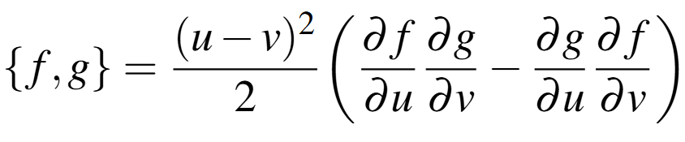

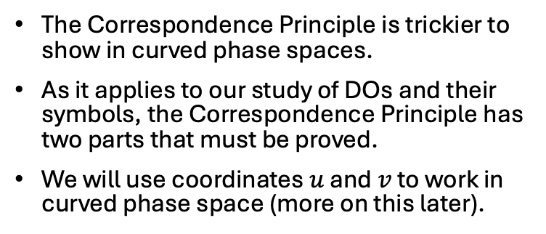
The Correspondence Principle
The Correspondence Principle is trickier to show in curved phase spaces.
As it applies to our study of DOs and their symbols, the Correspondence Principle has two parts that must be proved.
We will use coordinates $u$ and $v$ to work in curved phase space (more on this later).
Recovery of the commutative function product
Recovery of the Poisson bracket

Slide 7
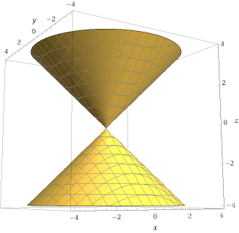
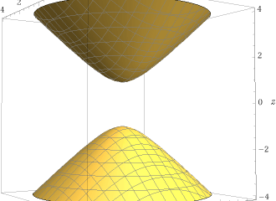
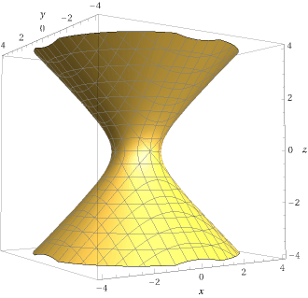



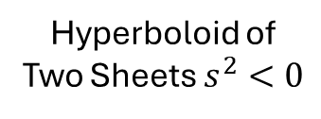
Hyperboloids
A surface in $ℝ^{3}$ where all points $(x,y,z)$ on the surface satisfy $x^{2}+y^{2}−z^{2}=s^{2}$ where $s$ is the central radius.
Since it is a surface, points on the surface can be defined locally with just two coordinates that we call $u$ and $v$.
We focus our attention on hyperboloids of one sheet.
Hyperboloid of Two Sheets $s^{2}<0$
Infinite Cone $s^{2}=0$
Hyperboloid of One Sheet $s^{2}>0$

Slide 8
Goals
Define symbols and the symbol product constrained to the surface of a hyperboloid of one sheet such that they satisfy the Correspondence Principle.
Ensure that our symbols and DOs are equivariant
Draw further corrections between symbols and physical principles.

Slide 9
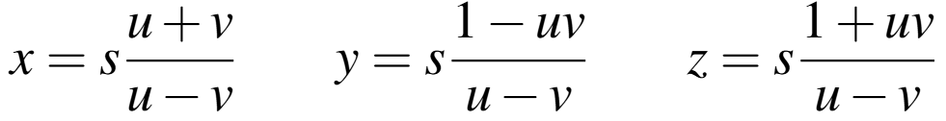
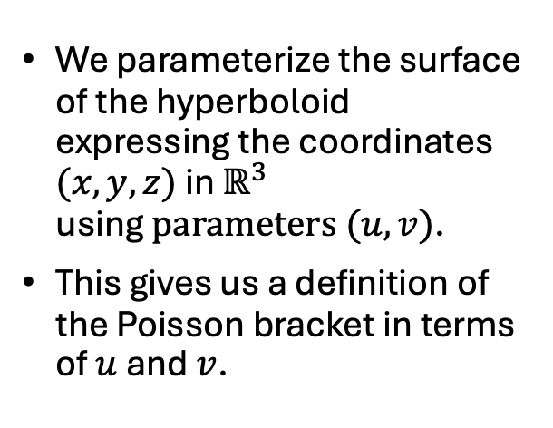
Coordinate Transforms
We parameterize the surface of the hyperboloid expressing the coordinates $(x,y,z)$ in $ℝ^{3}$ using$parameters (u,v)$.
This gives us a definition of the Poisson bracket in terms of $u$ and $v$.
Coordinate transforms

Slide 10
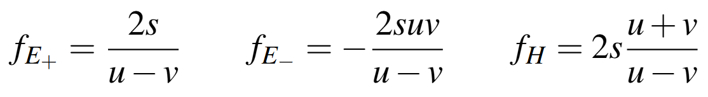
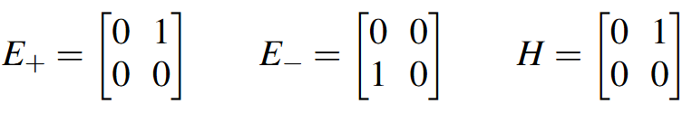
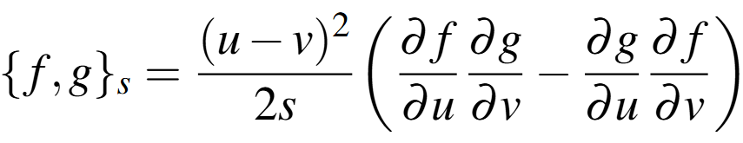
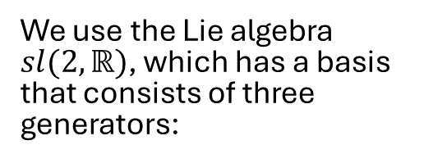
Hamiltonians
We can use these to derive the corresponding Hamiltonians (these are symbols):
We use the Lie algebra $sl(2,ℝ)$, which has a basis that consists of three generators:

Slide 11
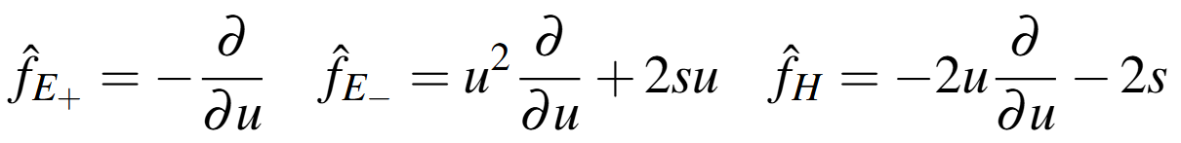
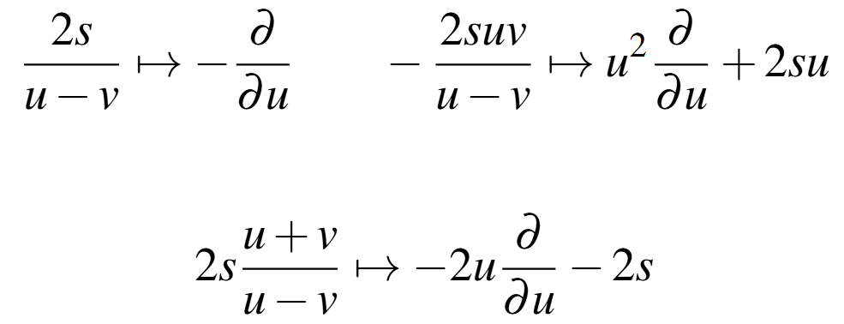
Hamiltonians
We find the corresponding DOs that satisfy the needed commutation relations:
We now have homomorphisms relating DOs and symbols:

Slide 12
A Physical Application

Slide 13
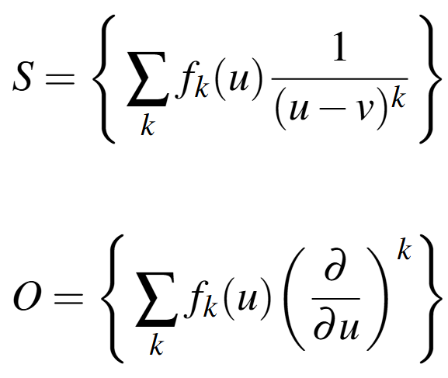
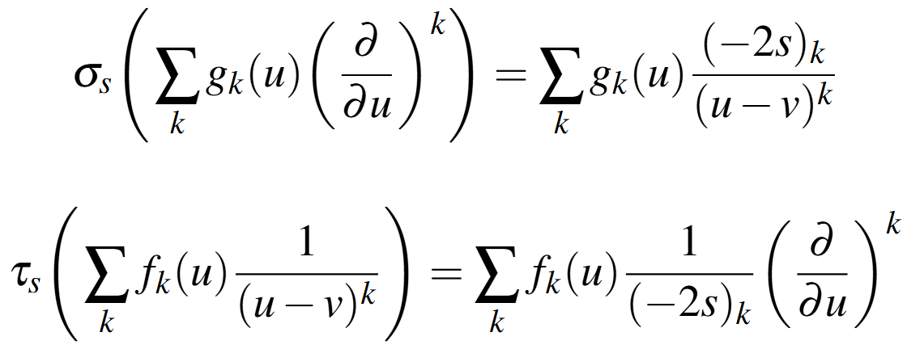

DO and Symbol Mappings
We generalize our findings so far to construct the space of symbols and the space of DOs:
We can then use the mappings $σ_{s}:O\overset{→}{}S$ and $τ_{s}:S\overset{→}{}O$ defined as:

Slide 14

Result - The Symbol Product
We can now the define the symbol product that we have been looking for!
The result of this product is another symbol.
It follows from the composition of DOs.
It can be shown that it satisfies both parts of the Correspondence Principle.
It can also be shown to be have equivariance under the symmetry group SL(2,R).
{
{
DO
DO

Slide 15
Discussion
We have demonstrated a procedure for developing and using the symbol product on a hyperboloid.
This extends our ability to perform QM calculations to curved phase spaces.
The Correspondence Principle means that our symbol product remains valid in the classical limit.

Slide 16
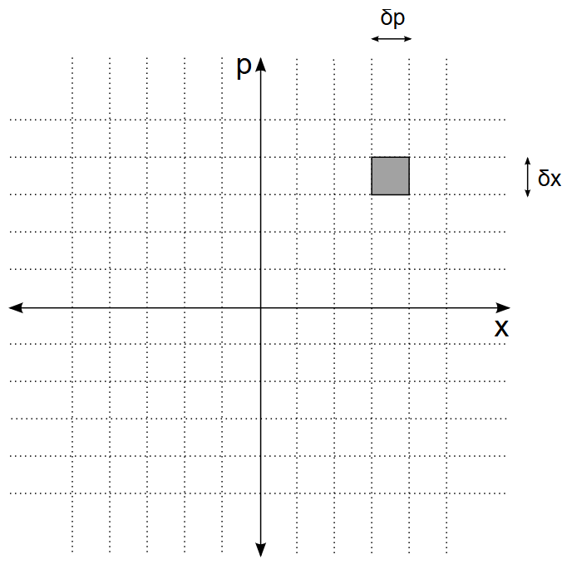



Conclusion
Commonly-used DOs in QM often lead to messy calculations, especially in curved phase spaces.
We have shown symbols constrained to a hyperboloid’s surface and shown that they satisfy the Correspondence Principle.
Future work: Learn more about the functions on the hyperboloid, e.g. various subalgebras.
Flat
Curved
Our work
QM
Well-known CP
Shown CP
$$p$$
$$s\overset{→}{}∞$$
$$q$$
2. the Statistical Description

Slide 17
References
“2. the Statistical Description of Physical Systems¶.” 2. The Statistical Description of Physical Systems - Introduction to Statistical Mechanics, web.stanford.edu/~peastman/statmech/statisticaldescription.html. Accessed 11 Apr. 2025.
Bokulich, Alisa, and Peter Bokulich. “Bohr’s Correspondence Principle.” Stanford Encyclopedia of Philosophy, Stanford University, 13 Aug. 2020, plato.stanford.edu/entries/bohr-correspondence/.
“Quantum vs. Classical.” The Quantum Atlas, quantumatlas.umd.edu/entry/quantum-classical/. Accessed 11 Apr. 2025.
Suetin, P. K., et al. Linear Algebra and Geometry. CRC Press, 1989.

Slide 18
Acknowledgements
Huge thanks to Dr. Karabegov for his patience and advice.

